Slide 1

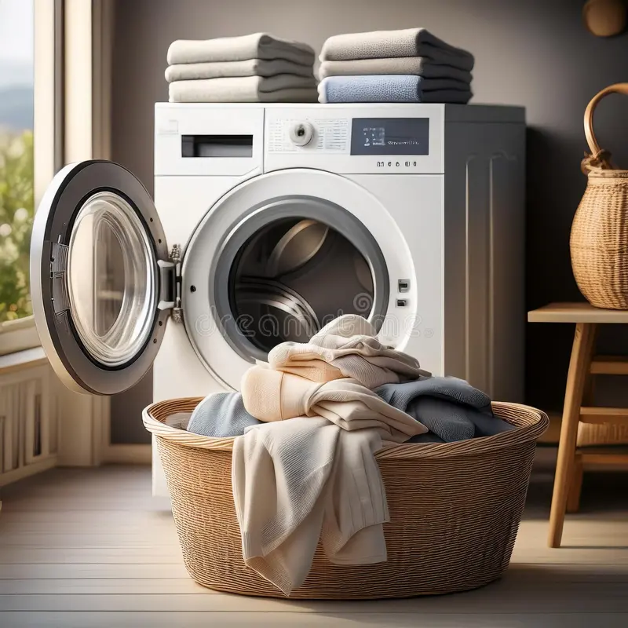

LAUNDRY AI: Automated Intelligent Network for Digital Resourceful Yard
Presented by
Name – Keshav
Enrollment - E23CSEU1538

Slide 2

Problem Statement
Manual Laundry Apps
Lack predictive ETA and foresight.
No Anomaly Detection
Issues cause delays without alerts.
Missing Intelligent Chat
No automated assistant or real-time help.

Slide 3

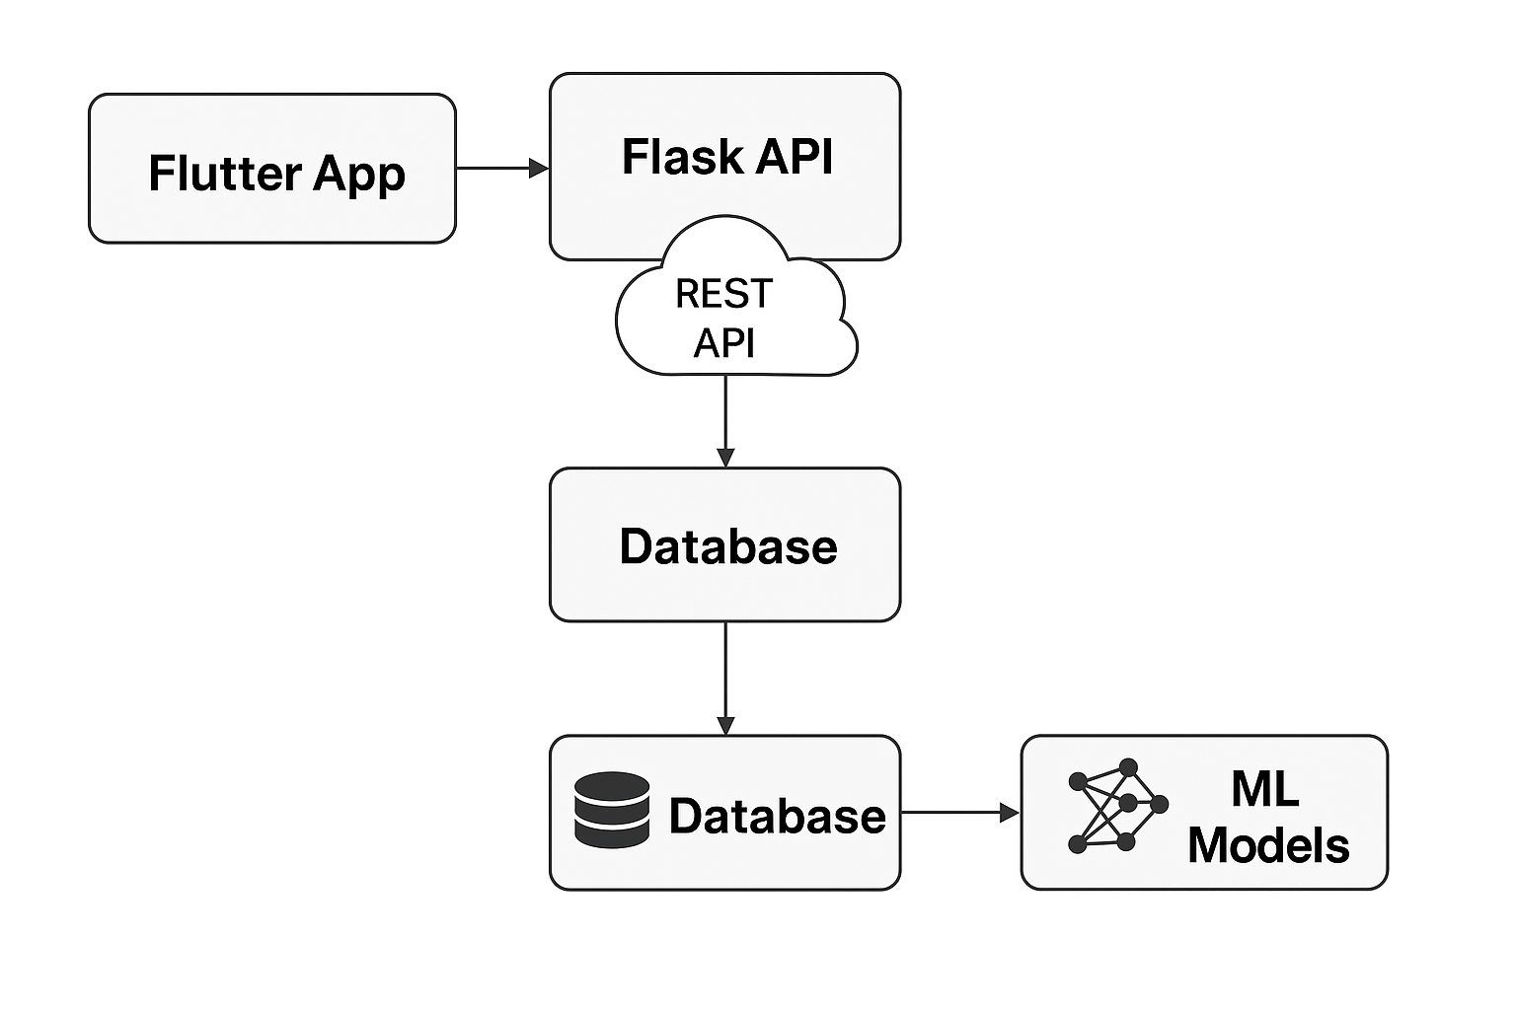
Proposed Solution
Predictive ETA
AI estimates laundry completion time accurately.
Anomaly Detection
Identifies irregularities early to avoid delays.
Chatbot Integration
Intelligent assistant answers user queries instantly.

Slide 4








System Architecture
User App
Flask API Server
Jupyter AI Models
Firebase Real-time Database
Tech Stack
Flutter
Firebase
Python
Flask
Scikit-Learn
GitHub
Jupyter Notebook

Slide 5
System Architecture
User App
Flask API Server
Jupyter AI Models
Firebase Real-time Database
Tech Stack
Flutter
Firebase
Python
Flask
Scikit-Learn
GitHub
Jupyter Notebook

Slide 6
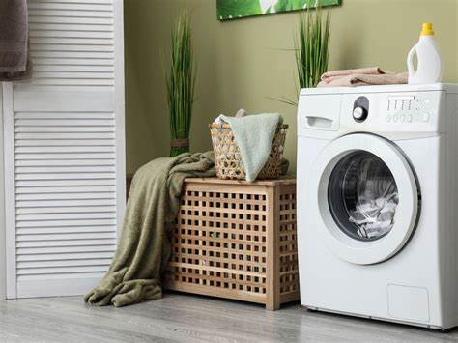

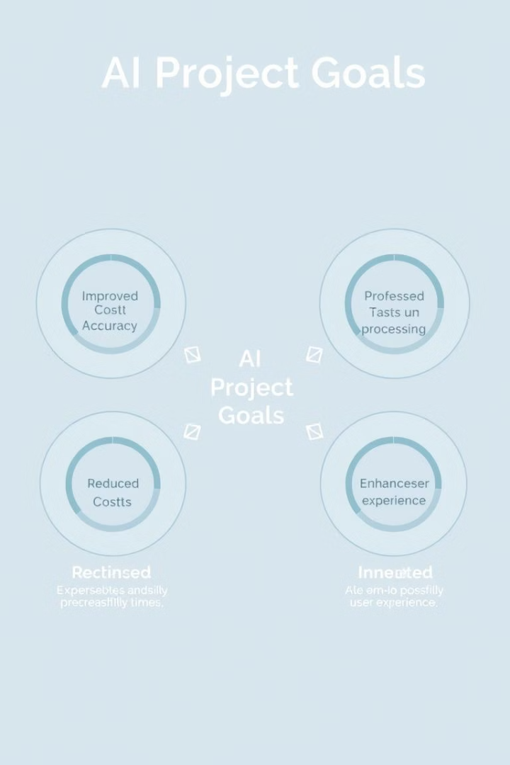
Project Goals
UI Mock-Up
Future Work
STAFF
Prediction Accuracy
≥ 90%
Anomaly Flagging
Real-time alerts
Chatbot Efficiency
High responsiveness
Security
Data privacy and protection
Documentation
Comprehensive and clear

Slide 7
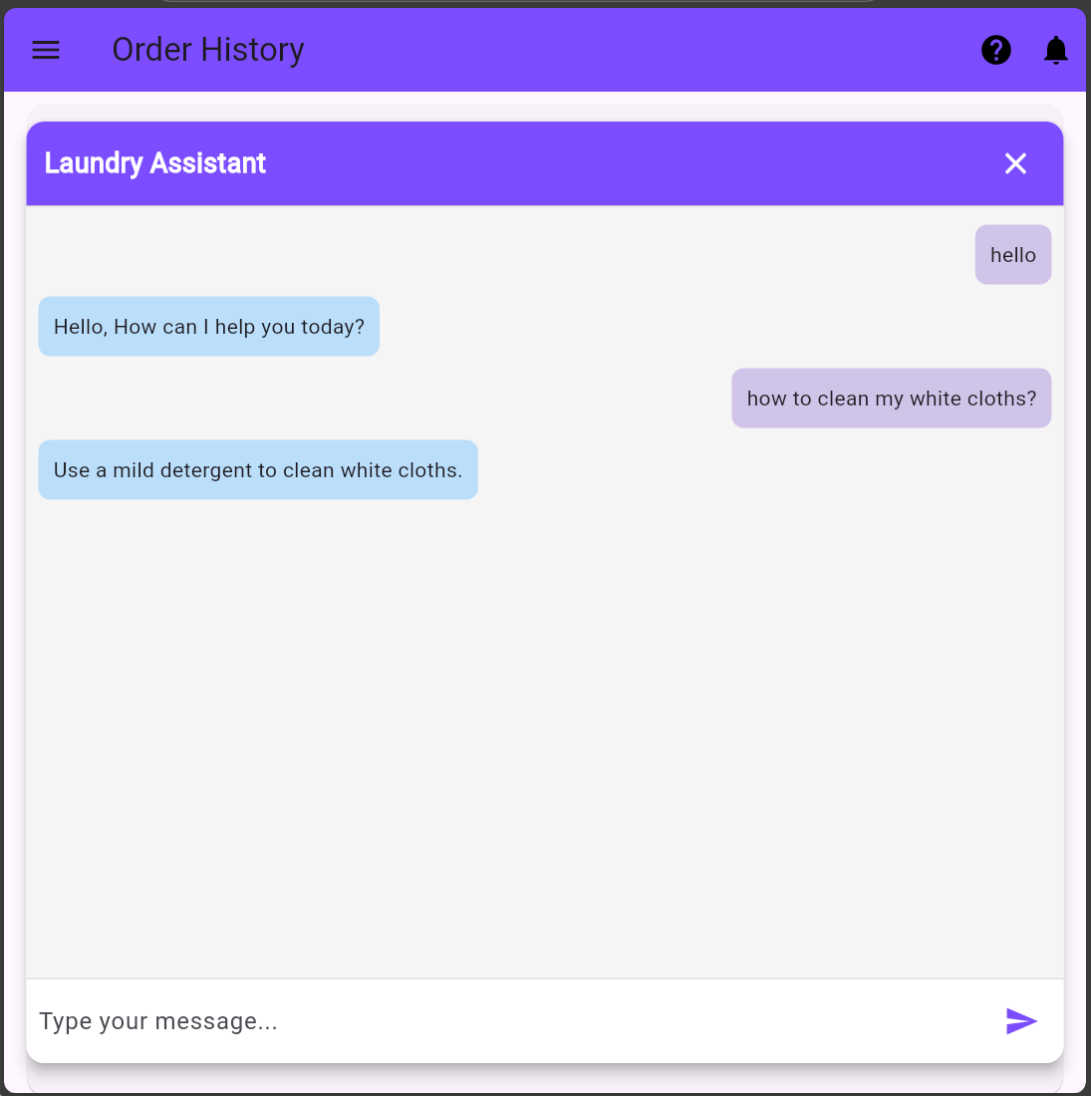
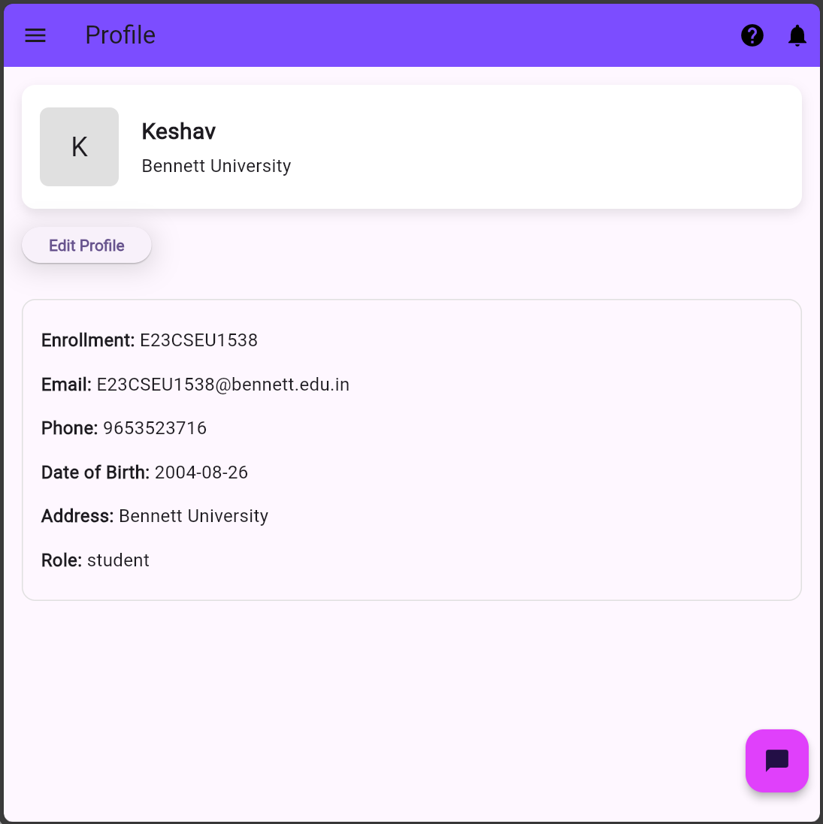
Project Goals
UI Mock-Up
Future Work
STAFF
Chat Interface
Intuitive chatbot assists users in real-time.
Need Help??

Slide 8
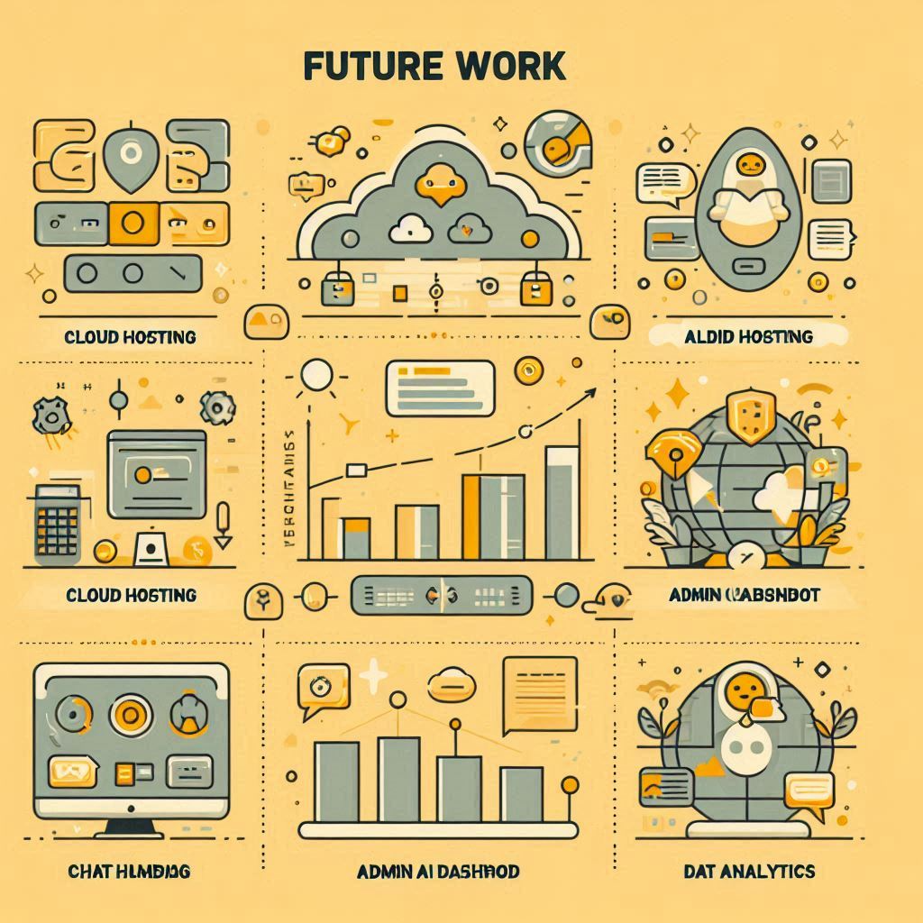
Project Goals
UI Mock-Up
Future Work
STAFF
Expand dataset across semesters
Move models to cloud (Firebase Functions / GCP)
Enhance chatbot with large language models
Add Admin/Staff-side AI insights

Slide 9


